Slide 1
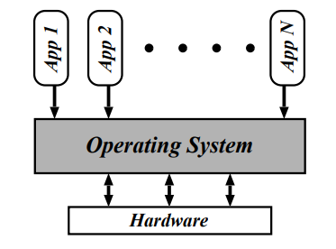

RECAP – SESSION-1: Questions answered : What will you do in this course? What is an OS and why do you want one? Why study operating systems?
Acts as an intermediary between the user(s) and the computer
System software which controls the components of computer system and coordinates the execution of all other programs (applications).
The Operating System (OS) is a resource manager
Hides the complexity and provide convenient environment
For us, the OS ≈ the kernel.

Slide 2
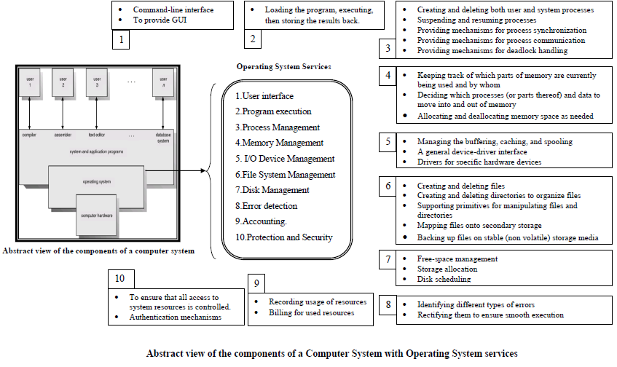

Slide 3
Session 2 Outcome : Understand Operating Systems Design Approaches
OS DESIGN APPROACHES
Simple
Monolithic
Layered
Microkernel
Modular
Hybrid
iOS
Android

Slide 4
Internal structure of different Operating Systems can vary widely
Start by defining goals and specifications
Affected by choice of hardware, type of system(Portability)
User goals and System goals
User goals – operating system should be convenient to use, easy to learn, reliable, safe, and fast
System goals – operating system should be easy to design, implement, and maintain, as well as flexible, reliable, error-free, and efficient
Important principle to separate
Policy: What will be done? Mechanism: How to do it?
Mechanisms determine how to do something; policies decide what will be done
The separation of policy from mechanism is a very important principle, it allows maximum flexibility if policy decisions are to be changed later
Operating System Design Approaches

Slide 5
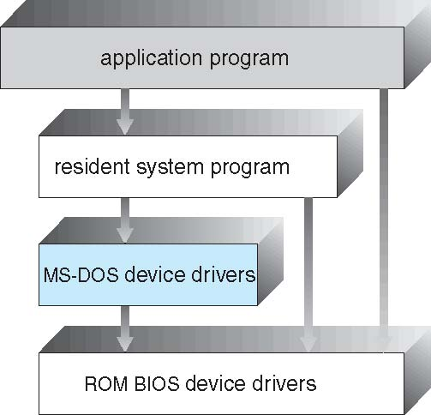
Simple Structure-
MS-DOS Layer Structure
MS-DOS – written to provide the most functionality in the least space
Not divided into modules
Although MS-DOS has some structure, its interfaces and levels of functionality are not well separated

Slide 6
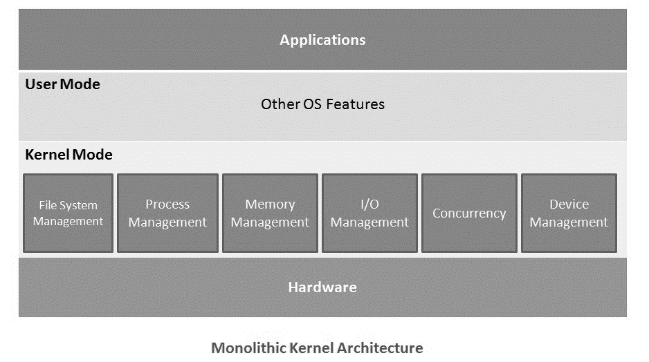
Monolithic architecture
Monolithic kernel has all the operating system functions or services within a single kernel.
Run as a single process in a single address space in memory.
Less flexible for modifications
Kernel mode and User mode
Kernel mode - has all the primary or core operation system features
User mode has the operating system features not added in the kernel mode
Windows 95, 98, ME.
All Linux distributions.
Android uses a modified Linux Kernel

Slide 7
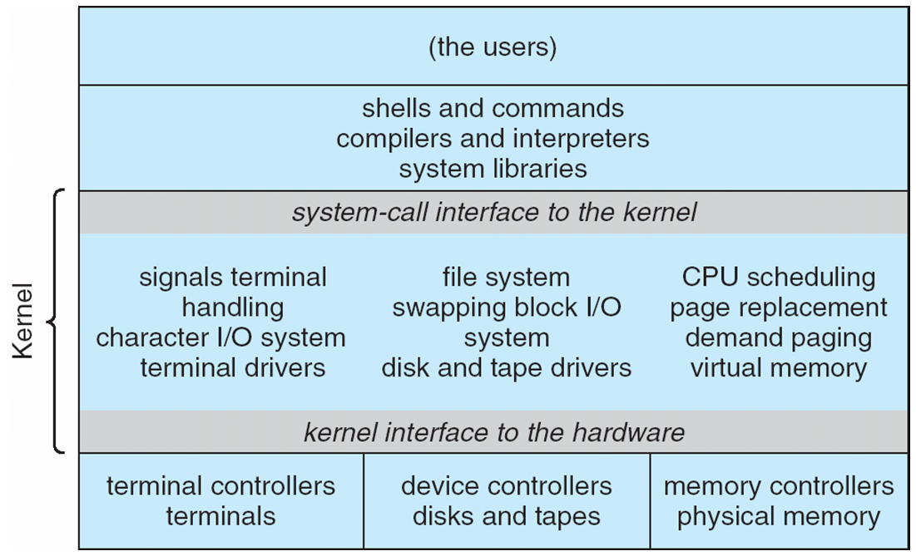
Beyond simple but not fully layered
Monolithic Structure – Original UNIX
UNIX – limited by hardware functionality, the original UNIX operating system had limited structuring. The UNIX OS consists of two separable parts
Systems programs
The kernel
Consists of everything below the system-call interface and above the physical hardware
Provides the file system, CPU scheduling, memory management, and other operating-system functions; a large number of functions for one level

Slide 8
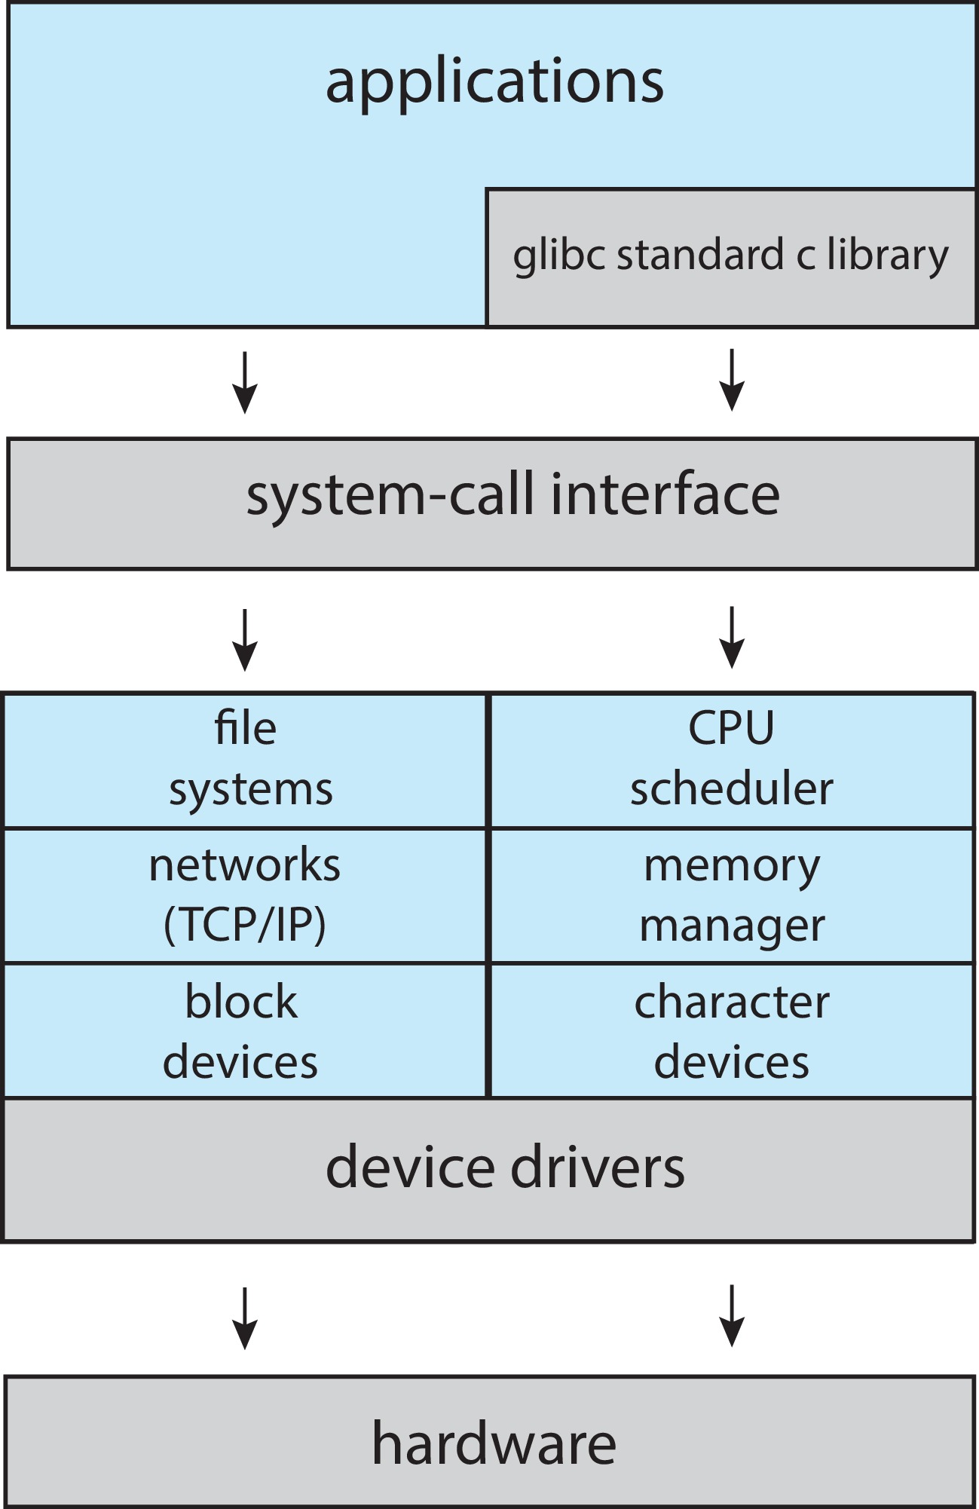
Monolithic plus modular design
Linux System Structure

Slide 9
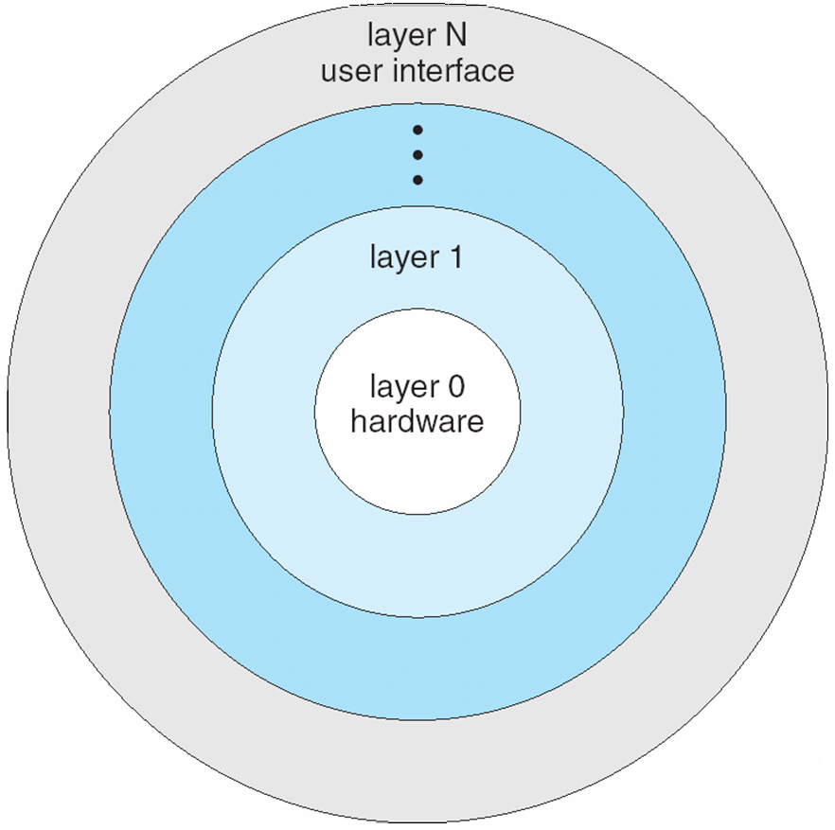
Layered Approach
A system can be made modular in many ways. One method is the layered approach, in which the operating system is broken up into a number of layers (levels).
The bottom layer (layer 0) id the hardware; the highest (layer N) is the user interface. ... This approach simplifies debugging and system verification.
With modularity, layers are selected such that each uses functions (operations) and services of only lower-level layers

Slide 10
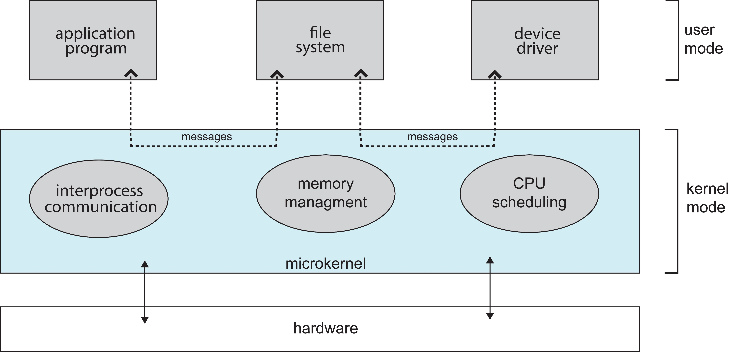
Kernel have the basic interaction with hardware and the basic Inter-Process Communication mechanisms.
All the other Operating System services exist outside the Kernel.
Flexibility to add or modify features
IPC, scheduling and memory management are the core services in a micro-kernel. Rest of the OS services exist as independent services.
Examples: Eclipse IDE, Mach, OKL4, Codezero, Fiasco.OC, PikeOS, seL4, QNX
Microkernel System Structure (Mac OS X Structure)
Moves as much from the kernel into “user” space
Communication takes place between user modules using message passing
Benefits:
Easier to extend a microkernel
Easier to port the operating system to new architectures
More reliable (less code is running in kernel mode)
More secure
Detriments:
Performance overhead of user space to kernel space communication

Slide 11
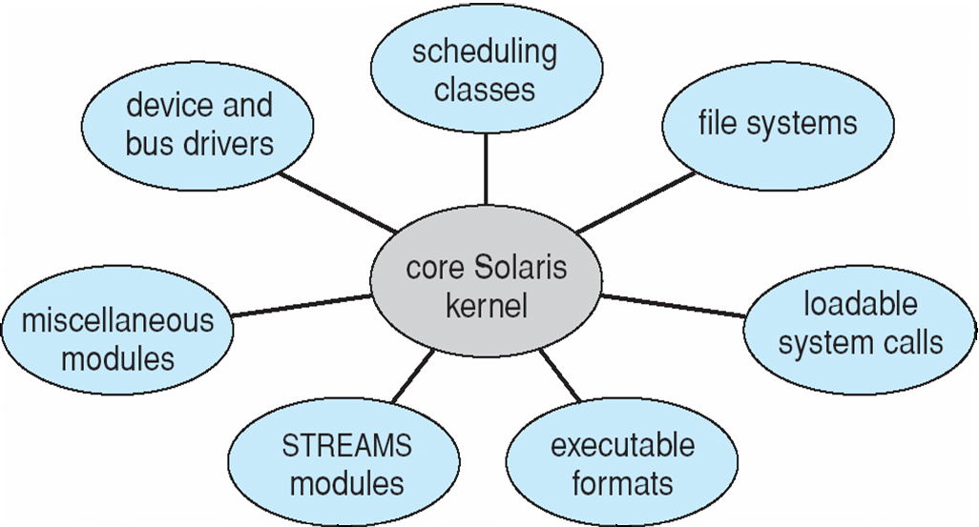
Modules
Solaris Modular Approach
Most modern operating systems implement kernel modules
Uses object-oriented approach
Each core component is separate
Each talks to the others over known interfaces
Each is loadable as needed within the kernel
Overall, similar to layers but with more flexible

Slide 12
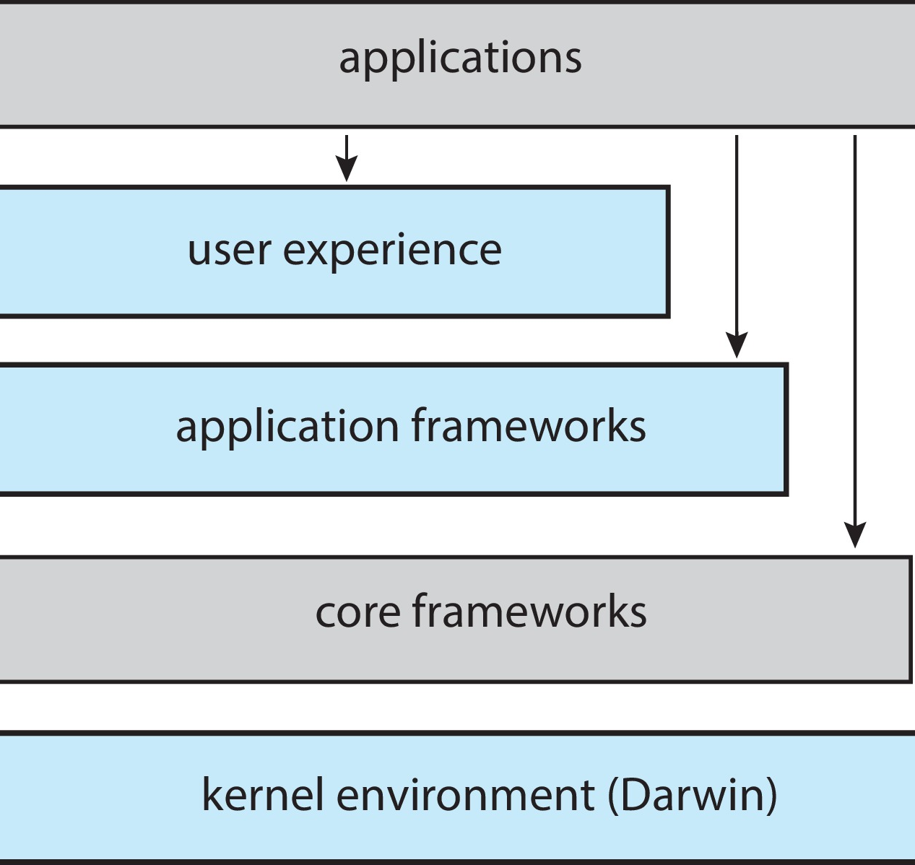
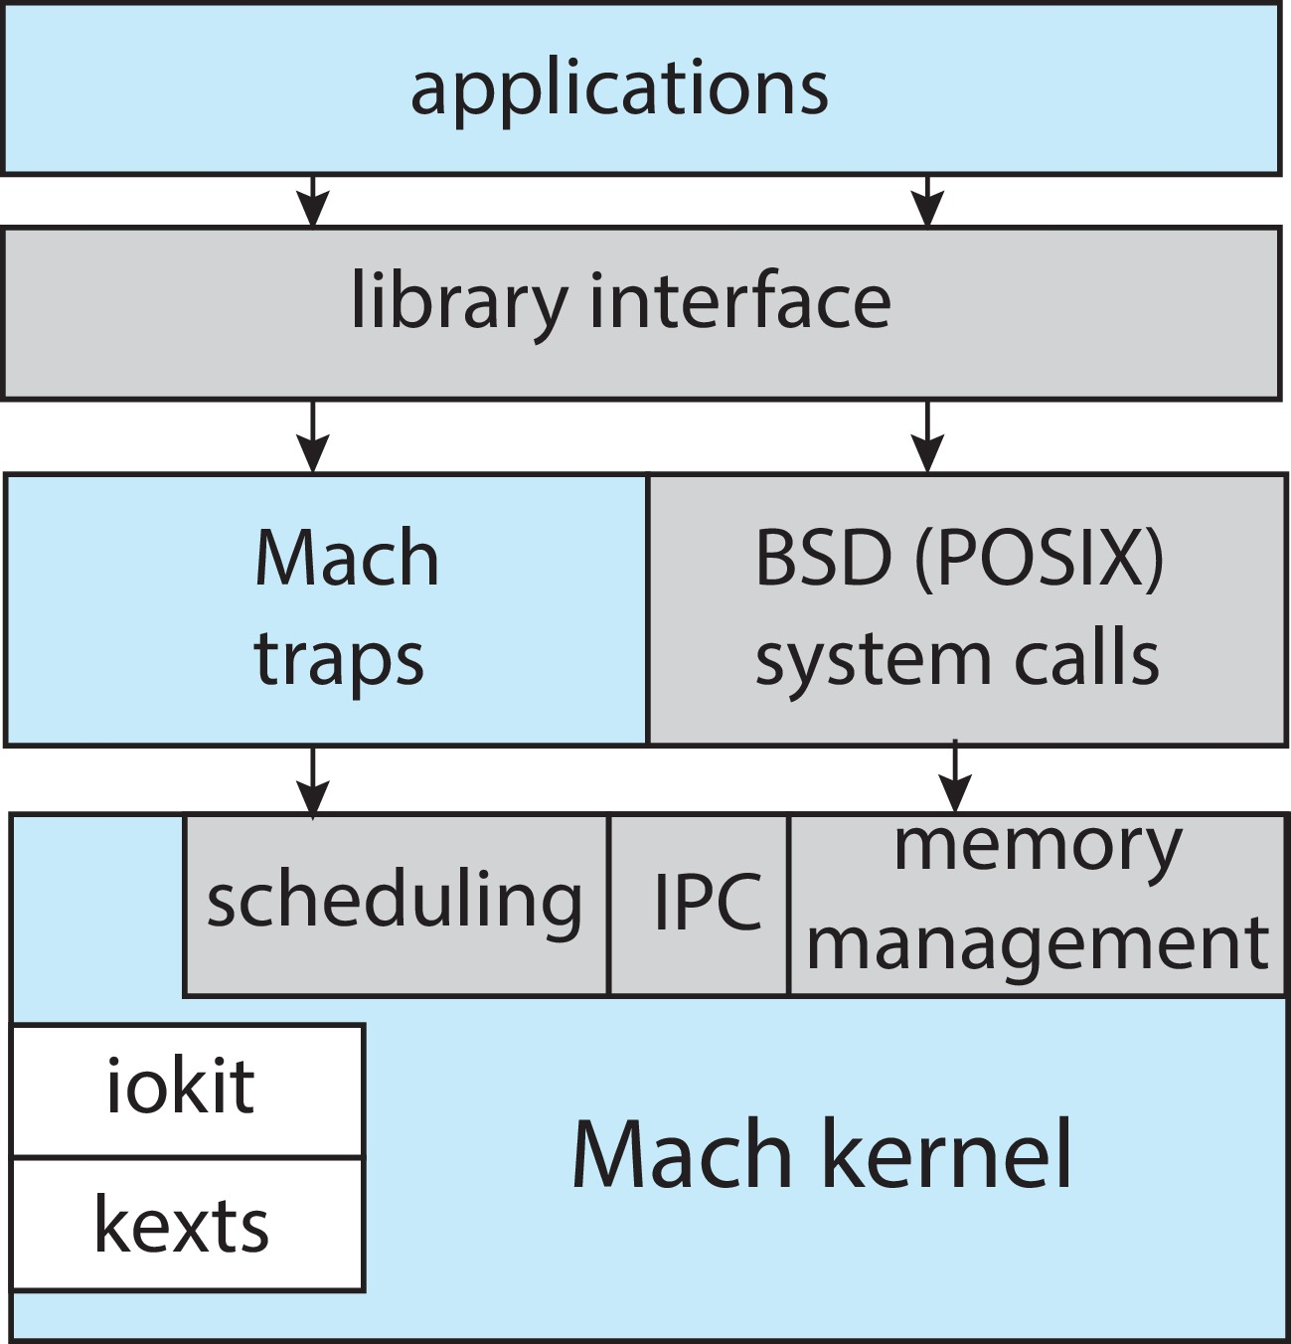
macOS and iOS Structure
Hybrid Systems
Hybrid architecture tries to get the best features of both monolithic kernel as well as microkernel.
Hybrid kernel aims to have an optimal performance and the flexibility to modify and upgrade kernel services.
Most modern operating systems are not one pure model
Linux and Solaris kernels in kernel address space, so monolithic, plus modular for dynamic loading of functionality
Windows mostly monolithic, plus microkernel for different subsystem personalities
Apple Mac OS X hybrid, layered, Aqua UI plus Cocoa programming environment. The kernel consisting of Mach microkernel and BSD Unix parts, plus I/O kit and dynamically loadable modules (called kernel extensions)
Darwin

Slide 13
iOS
Apple mobile OS for iPhone, iPad Structured on Mac OS X, added functionality
Cocoa Touch Objective-C API for developing apps
Media services layer for graphics, audio, video
Core services provides cloud computing, databases
Core operating system, based on Mac OS X kernel

Slide 14
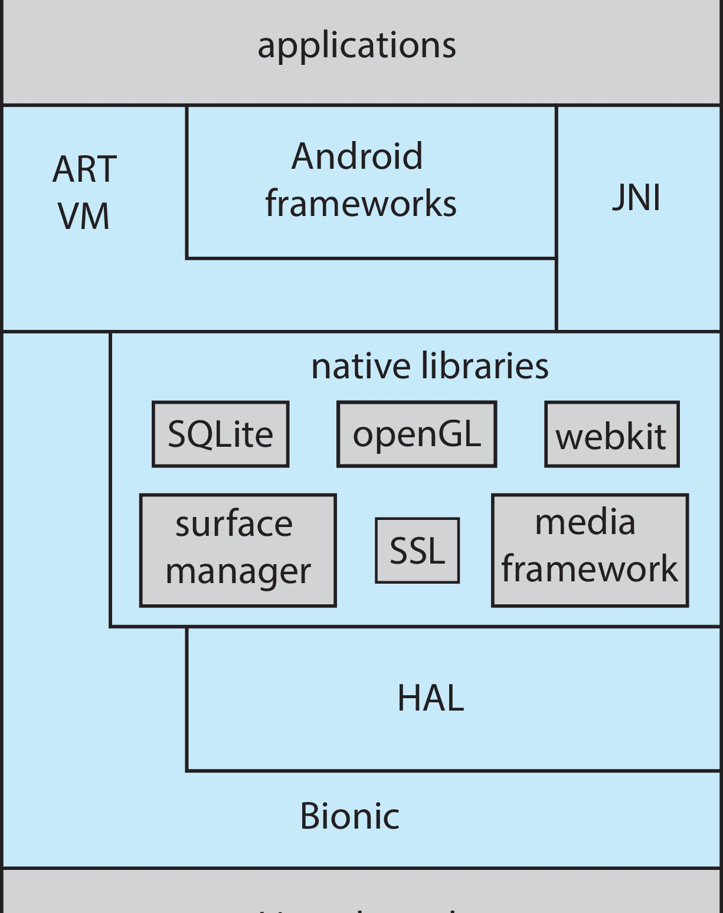
Android
Uses Linux kernel for underlying functionalities such as threading, key security features and low-level memory management.
HAL provides standard interfaces that expose device hardware capabilities to the higher-level Java API framework.
Android version 5.0 (API level 21) or higher, each app runs in its own process and with its own instance of the Android Runtime (ART).
ART, HAL and other components use Native C/C++ libraries.
The entire feature-set of the Android OS is available through APIs written in the Java language.
Apps developed in Java plus Android API. Java class files compiled to Java bytecode then translated to executable then runs in Dalvik VM
Libraries include frameworks for web browser (webkit), database (SQLite), multimedia, smaller libc

Slide 15
How does the OS start?
When OS is installed, it is stored on the hard disk, a non-volatile memory.
Bootloader is a program that loads the kernel into RAM when the computer is started.
Bootloader or bootstrap loader is stored in Read-only-Memory (ROM), EPROM or Flash memory.
Firmware: Every device such as keyboard, mouse, disk drives have firmware stored in its own ROM storage.
Firmware is a type of logic that hardwires the devices and provides software, an interface to interact with hardware device.

Slide 16
Kernel Architecture Design of Operating Systems

Slide 17
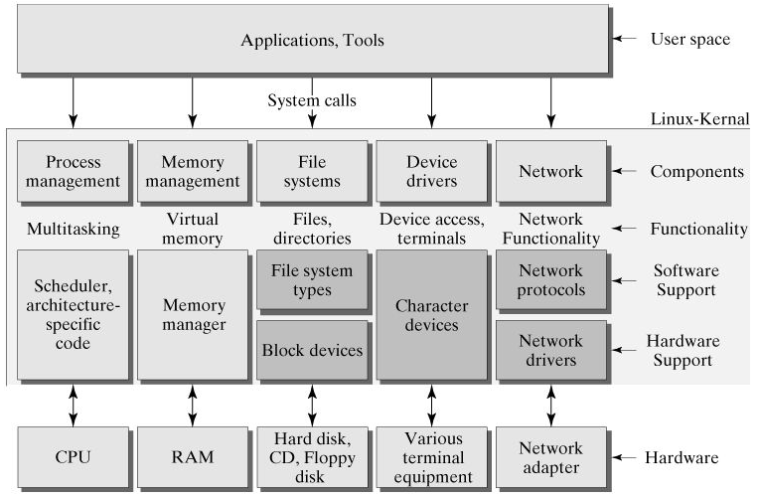
Linux Architecture
Linux has a monolithic Kernel.
System libraries and Device drivers that help Software applications to pass instructions to the Kernel or the Device drivers.
Device drivers are software's that interact (take input or provide output or both) with the firmware of the particular device.
User mode has applications or tools which in turn interact with Kernel directly or indirectly via system libraries, device drivers.

Slide 18
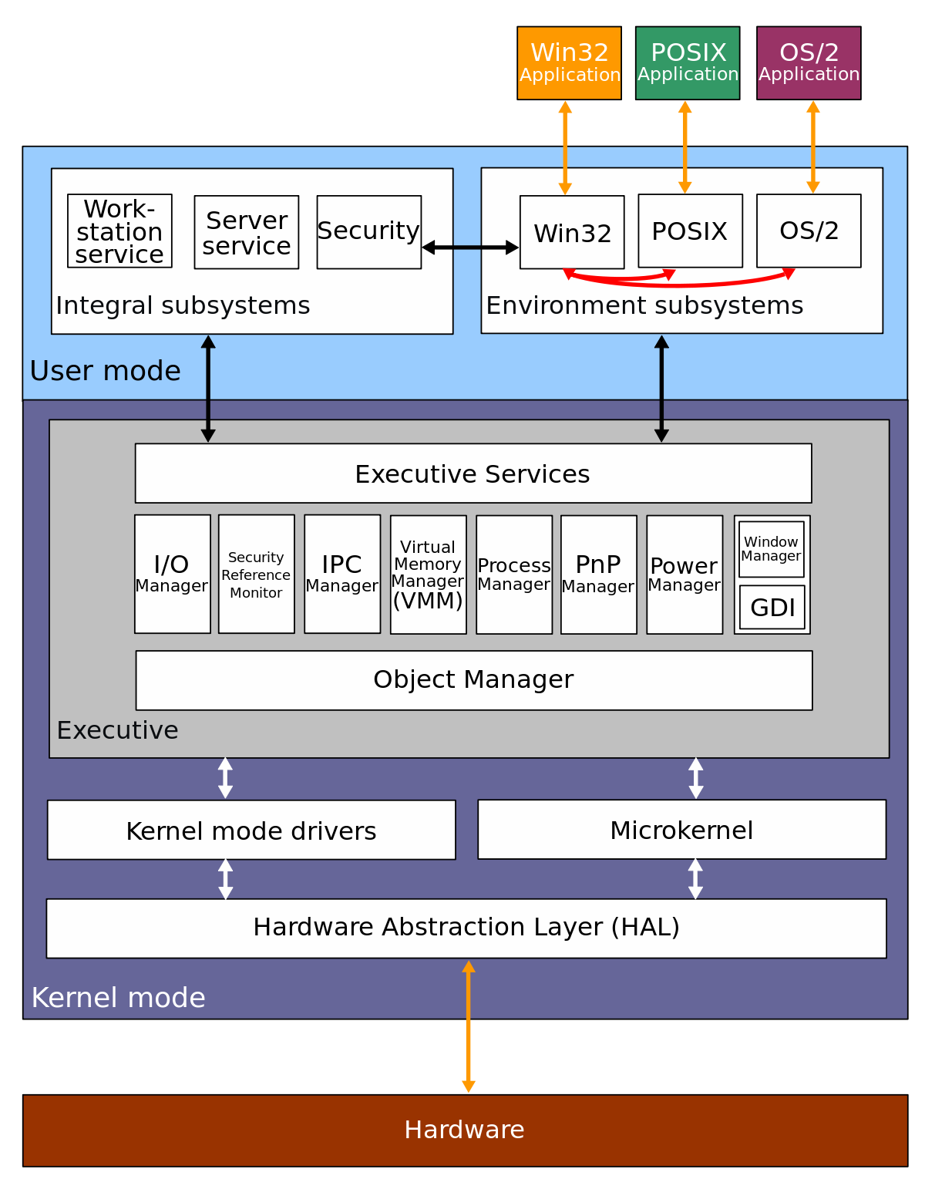
Windows NT Architecture
HAL was designed to hide differences in hardware and provide a consistent platform on which the kernel is run.
The Executive interfaces, with all the user mode subsystems, deal with I/O, object management, security and process management.
The kernel sits between the hardware abstraction layer and the Executive to provide multiprocessor synchronization, thread and interrupt scheduling and dispatching, and trap handling and exception dispatching.
The kernel is also responsible for initializing device drivers at bootup.

Slide 19
Kernel Architecture Implementation in Course

Slide 20
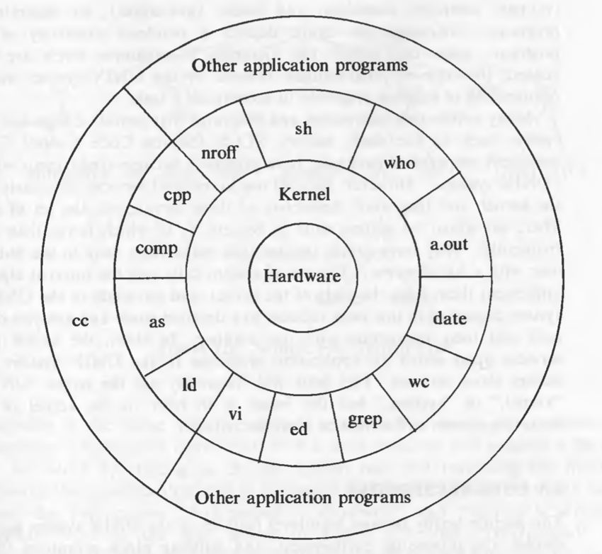
Unix Architecture
The operating systems interacts directly with the hardware, providing common services to programs and insulating them from hardware idiosyncrasies.
Programs such as the shell and editors shown in the outer layers interact with the kernel by invoking a well defined set of system calls.

Slide 21
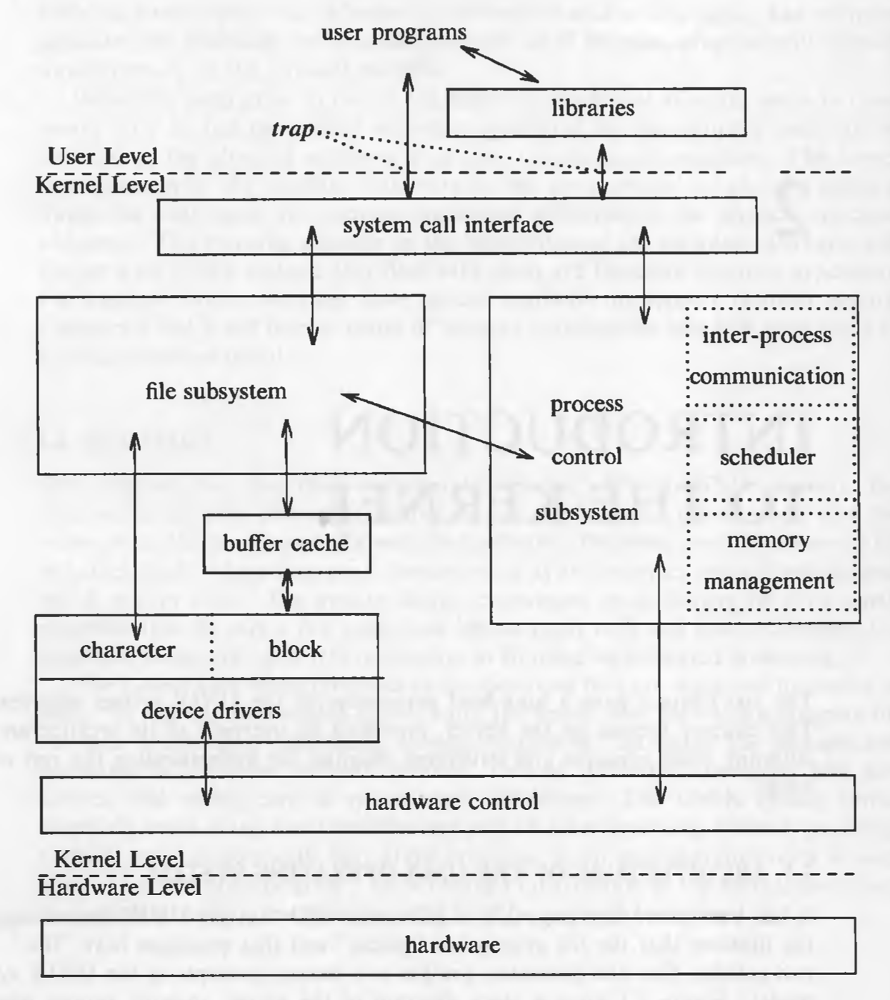
Unix Kernel
The two entities, files and processes, are the two central concepts in the UNIX system model.
The file subsystem is on the left and the process control subsystem is on the right.
The diagram shows 3 levels : user, kernel, and hardware.
The system call and library interface represent the border between user programs and the kernel.

